Slide 1

EXCELr project phase Bike-Rental regression Team no:2
Team Members
Avinash Kumar
Saini Sai Nithin
Sai Suman
Monessha N S
Mooram Gayathri

Slide 2
Problem Statement :
The business problem is to ensure a stable supply of rental bikes in urban cities by predicting the demand for bikes.By providing a stable supply of rental bikes, the system can enhance mobility comfort for the public and reduce waiting time,leading to greater customer satisfaction and accurately predicting bike demand can help bike sharing companies optimize operations including bike availability,pricing,strategies,and marketing efforts by considering demand Based on various external factors such as weather,season,holiday etc..,

Slide 3
Complete Workflow
EDA
Data Visualization
Feature Engineering
Model Building and evaluation
Model deployment

Slide 4

Exploratory Data Analysis (EDA)
Understanding data
Data Cleaning
Handling Missing values
Outliers Detection

Slide 5
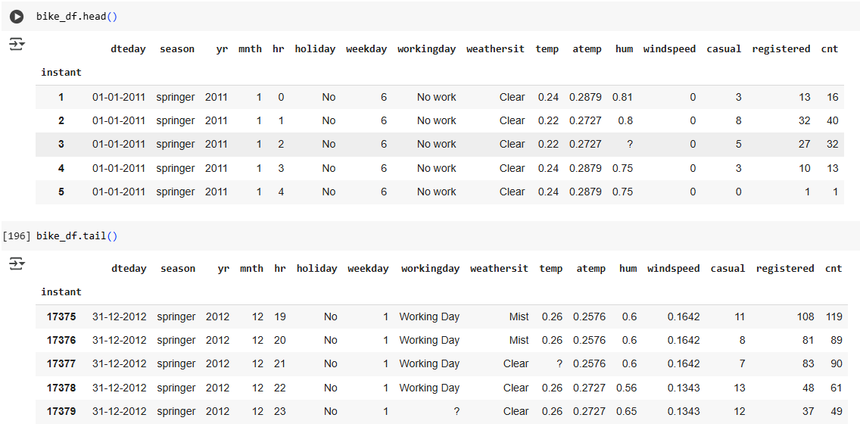
Describe the dataset: Understand the structure, columns.
Structure and column:
The data set contains 17379 rows and 16 columns
The dteday,hr,season and weathersit column indicates the time , day and season in a year
The temp,atemp,hum, windspeed column indicates the climatic parameters of a day
Casual and registered column indicates the number of users using with and without registeration

Slide 6
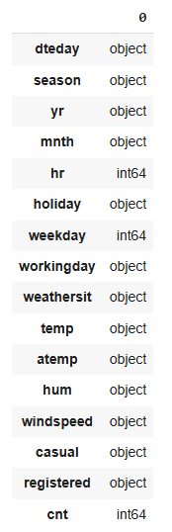
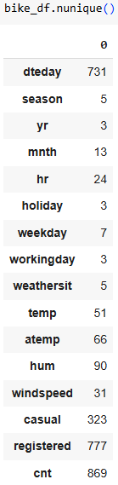
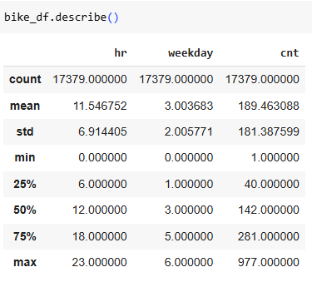
Describe the dataset: data types.
Statistical description of the data
Data types:
As shown in the image,the column like yr , mnth , temp , atemp , hum , windspeed , casual , registered columns has inappropriate data types which has to be processed
Unique number of values in each column

Slide 7
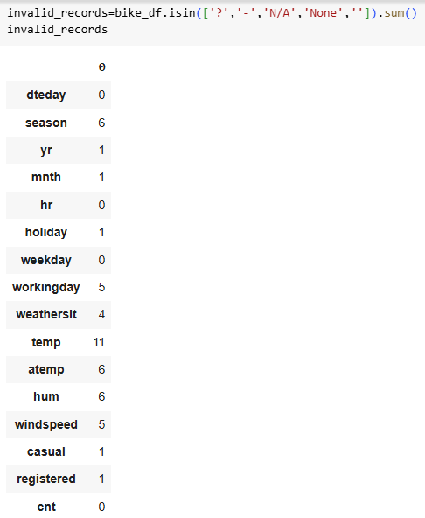
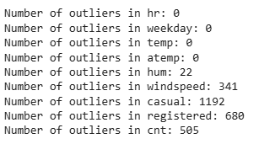
Clean the data: Check for invalid records, missing values, duplicated records and outliers
Checking for invalid Records/missing records :
- The given data is checked for any invalid records which include ? , N/A , - , None , space etc
These invalid records are replaced by nan
This can either be dropped or replaced.
Checking for duplicated records:
This data set doesnot contain any duplicated records
Checking for outliers:
The number of outliers in each column is displayed.
This can either be dropped or replaced.

Slide 8
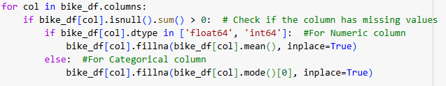
Handle missing values: Detect missing values and apply appropriate imputation techniques.
The missing values are identified and appropriate operations are done over that
If the data type of column is object , the nan value are replaced by mode
If the data type of column is int/float , the nan value are replaced by mean

Slide 9
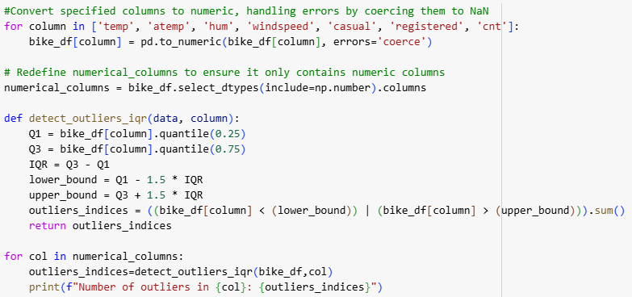
Detect outliers: Identify outliers and decide whether to remove or transform them.
Here the outliers are identified using quantile method.
Decision is made to remove all the outliers since the dataset is huge

Slide 10
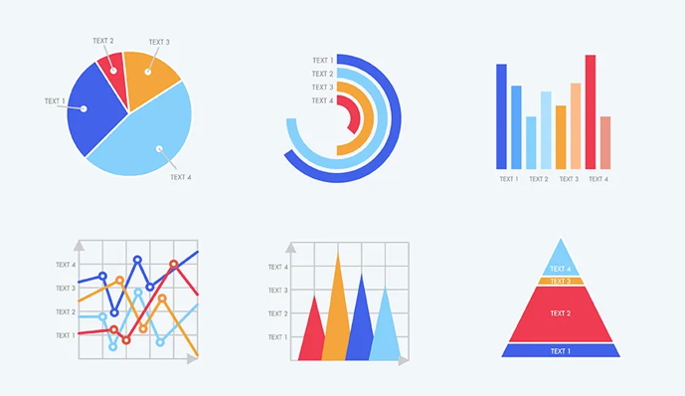
Data Visualization:
Time series
Heatmap
Scatter plots, line plots, and bar plots

Slide 11
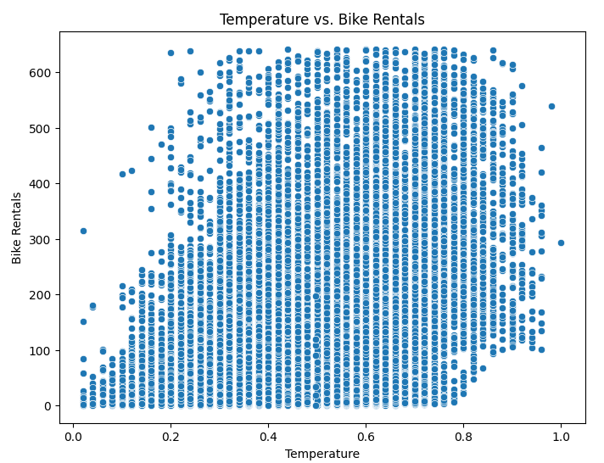
Creating visualizations such as scatter plots, line plots, and bar plots to explore relationships between variables.
A plot between temperature and bike rentals show that Rentals increase with moderate temperatures,peaking at an ideal range(e.g., 20–30°C) and Extremely high or low temperatures reduce rentals due to user discomfort.

Slide 12
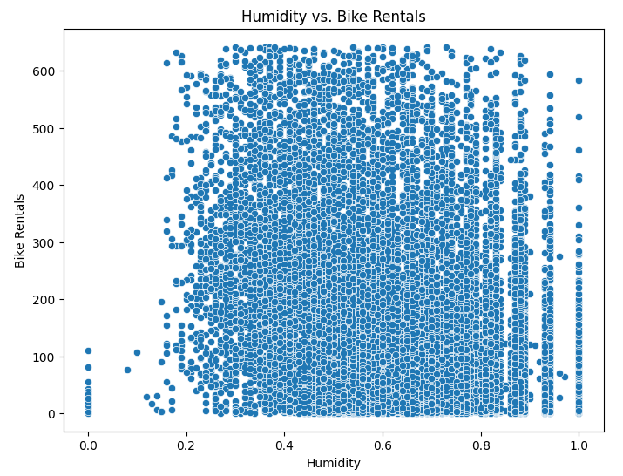
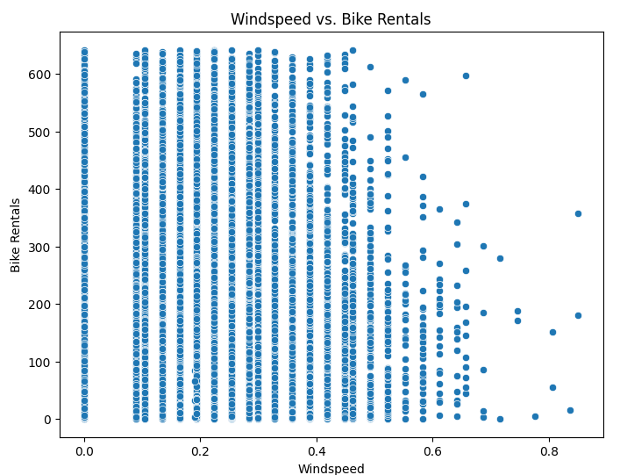
A plot between humidity and bike rentals show that Higher humidity (above 80%) might negatively affect bike rentals.Mostly Moderate humidity levels (40–70%) may correlate with higher rentals as conditions are more comfortable.
A plot between windspeed and bike rentals show that Rentals decline as windspeed increases,especially above a certain threshold(e.g.,>20 km/h),due to challenging riding conditions and Lower wind speeds are more favorable for bike users.

Slide 13
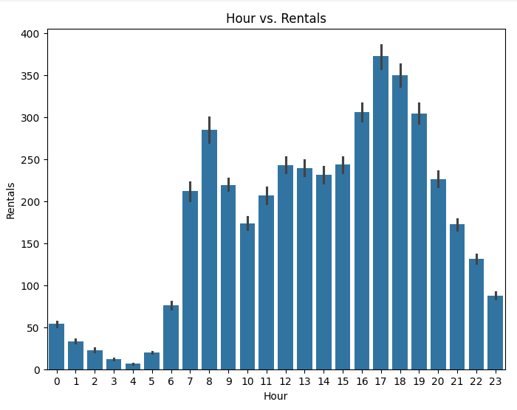
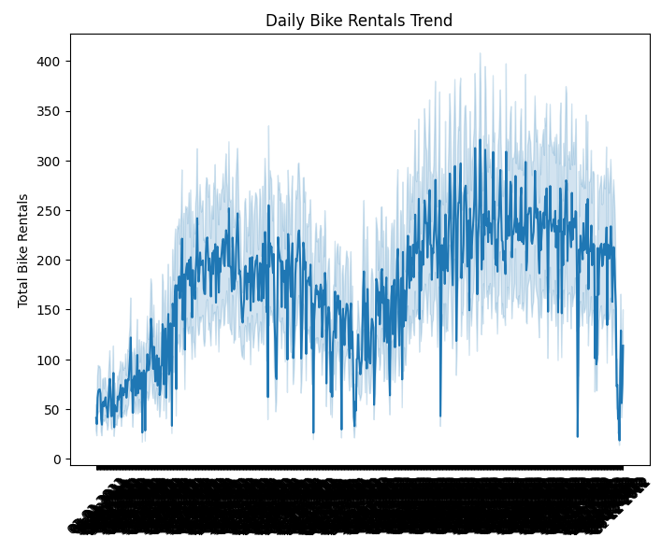
A plot for hourly basis bike rentals show that Rentals spike during commute hours (8–10 AM,5–7 PM) on working days.In Non-working days it peaks in the afternoon (12 PM–3 PM), likely due to leisure activities.
A plot for daily basis bike rentals show that Rentals may show an increasing trend over time due to the growing popularity of the service.Clear seasonality: higher rentals in spring/summer and lower in winter.

Slide 14
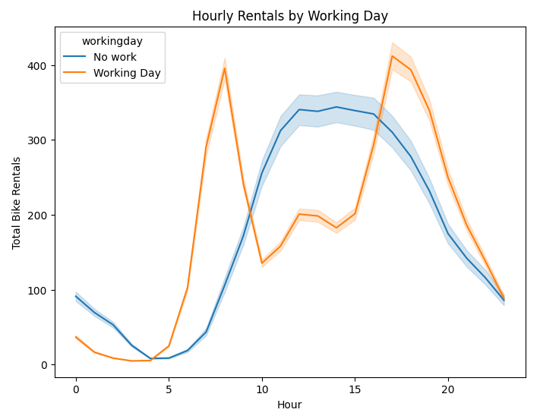
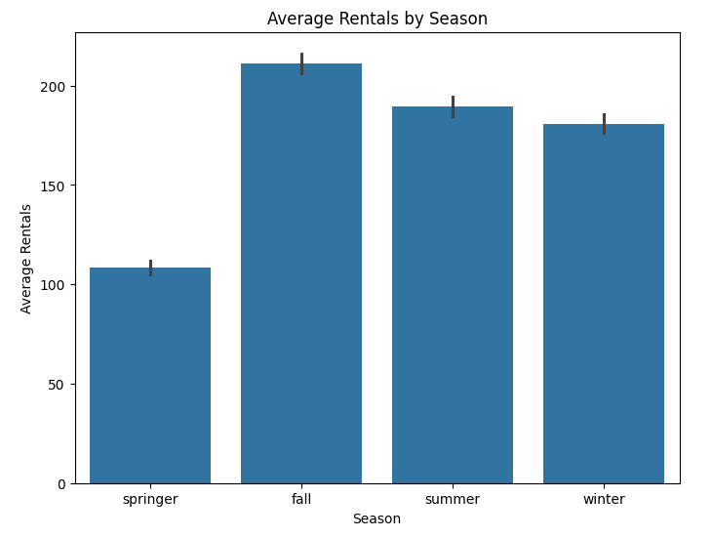
A plot for hourly basis bike rentals on working and no working day shows that In Spring/Summer: Higher overall rentals with mid-day peaks.In Winter/Fall: Lower rentals throughout the day, indicating seasonal weather impacts.
A plot between humidity and bike rentals show that Spring and summer have higher bike rentals due to favorable weather where as winter shows the lowest rentals due to harsh weather conditions.

Slide 15
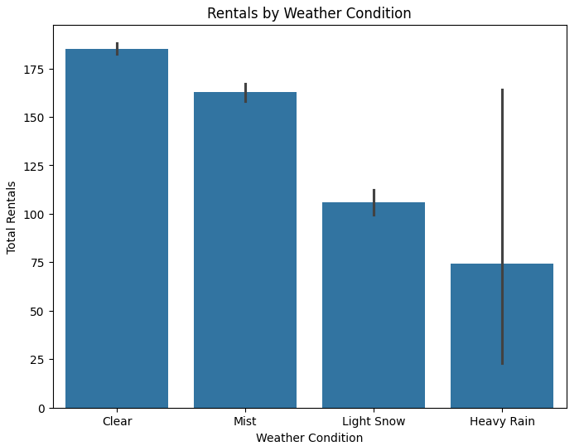
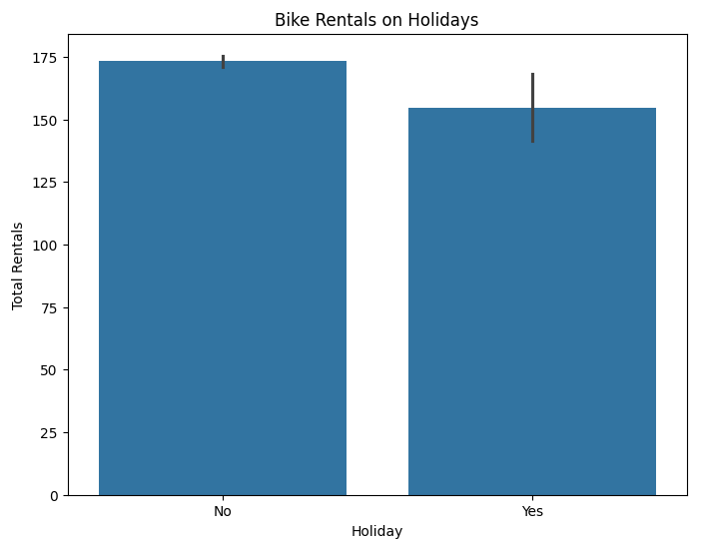
A plot for weather basis bike rentals show that Clear weather leads to significantly higher rentals and Poor weather (e.g.,rain,snow) results in fewer rentals.
A plot for bike rentals on holidays show that Rentals are slightly lower on holidays, as fewer people commute and Casual rentals may increase depending on the holiday type.

Slide 16
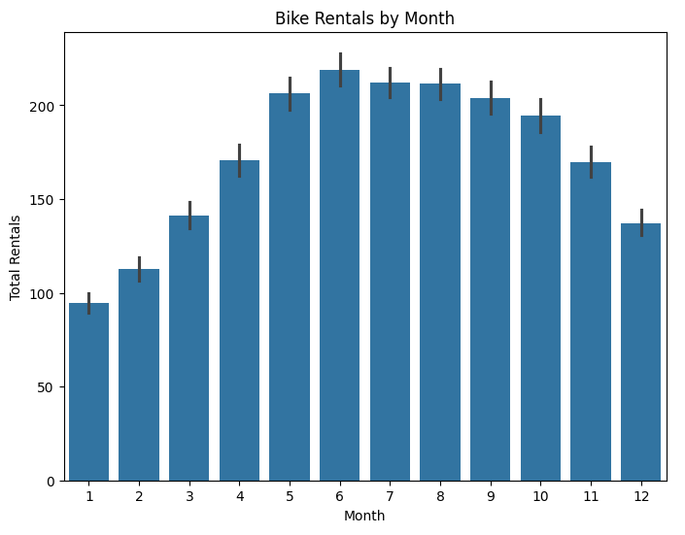
A plot bike rentals on monthly basis in a year show that Rentals peak during warmer months (e.g., May–August) and Cold months(e.g.,December–February) show a drop in bike usage.

Slide 17
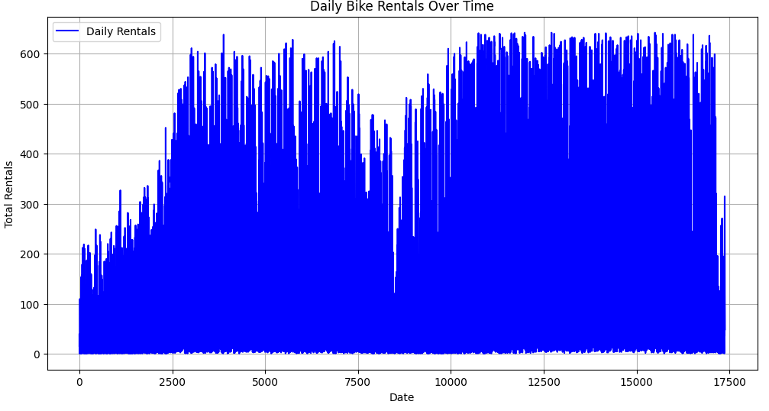
Plotting time series data to analyze trends and seasonality.

Slide 18
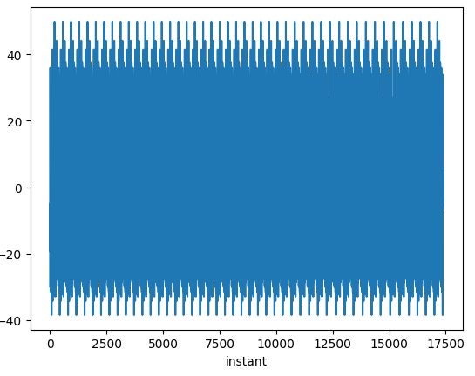
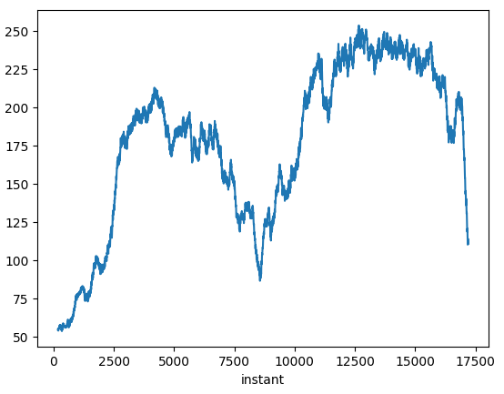
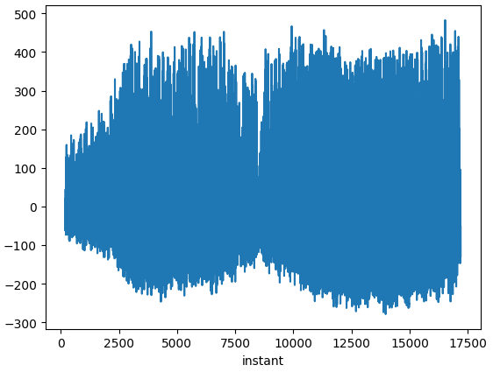
Seasonal plot
Trend
Residual plot
Trend: Rentals show a clear upward trend, reflecting increased popularity.
Seasonality: Rentals are higher in summer and lower in winter, following annual weather patterns.
Residuals: Spikes or dips could indicate outlier events like weather disruptions or holidays.

Slide 19
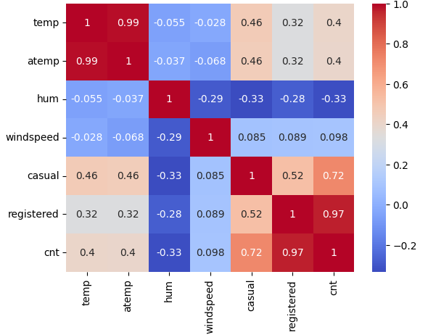
Using heatmaps or correlation matrices to understand the correlation between different features.
1)Temperature and atmospheric temperature has highest positive correlation(multi collinearity)
2)Registered and cnt temperature has highest positive correlation(multi collinearity)

Slide 20
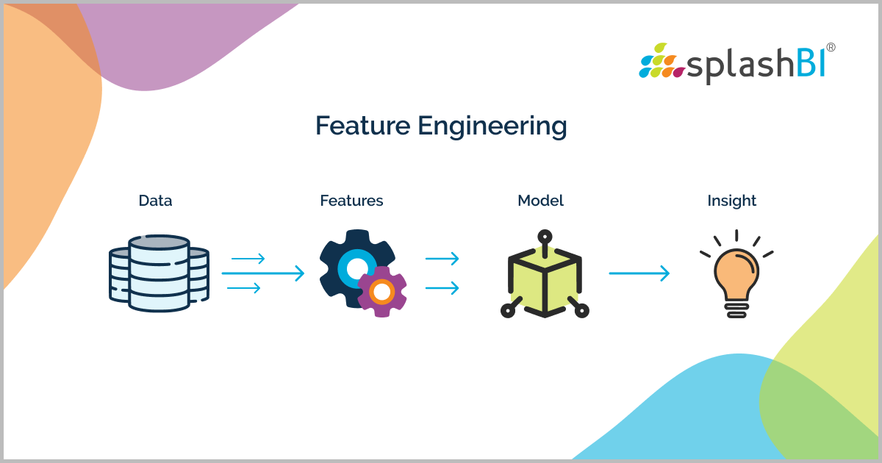
Feature Engineering
New feature generation
Encoding categorical column
Feature and target separation
Scaling the features

Slide 21
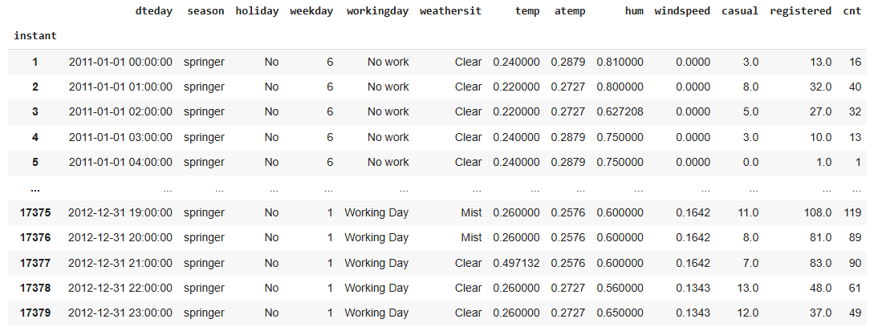
Generating new features from existing ones to improve model performance.
The hour,year and time column is dropped after the data in those are included in the dteday column

Slide 22
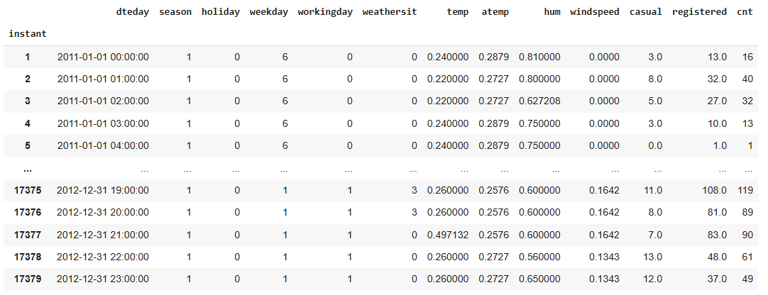
Handling categorical variables through techniques like one-hot encoding or label encoding.
Using label encoder to encode categorical columns like season, holiday and workingday
Label encoding may work well if the tree can naturally interpret the encoded values as representing an order or ranking.

Slide 23
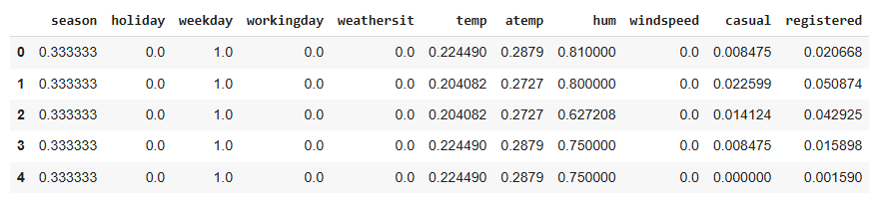
Scaling or normalizing numerical features to ensure uniformity in their ranges.
After the feature and target extraction from the encoded data , the feature is scaled using MinMax Scalar.
This scaling technique transform features by scaling each feature to a given range.(i.e)This estimator scales and translates each feature individually such that it is in the given range on the training set, e.g. between zero and one. where min, max = feature range.

Slide 24

Model Building:
machine learning algorithms such as Decision Tree, Random Forest, and Gradient Boosting Regression for predicting bike rental demand.
Splitting the dataset into training and testing sets
Training various models and evaluating them using metrics like RMSE, MAE, or R-squared.
Fine-tuning model parameters to optimize performance.

Slide 25
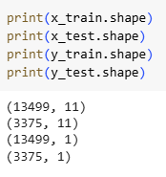
Splitting the dataset into training and testing sets for model evaluation.
Splitting the dataset into training and testing data with training size of 80%
After splitting the training set has 13499 rows and 11 columns whereas testing set has 3375 rows and 1 column.

Slide 26
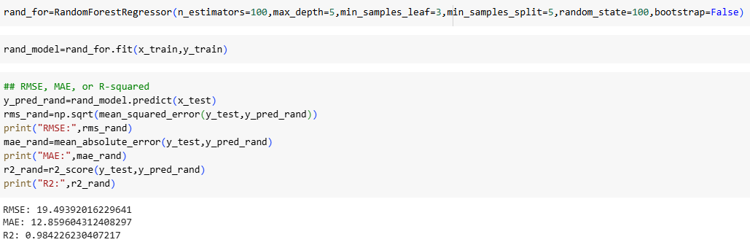
Selecting appropriate machine learning algorithms such as Decision Tree, Random Forest, and Gradient Boosting Regression for predicting bike rental demand.
Training various models using the training data and evaluating their performance using metrics like RMSE, MAE, or R-squared.
Random Forest

Slide 27
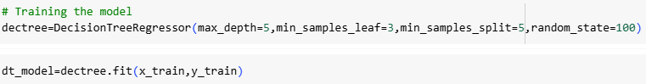
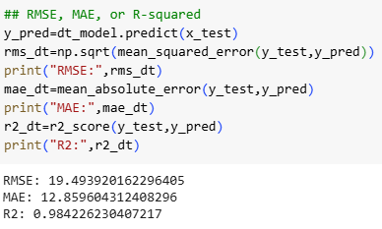
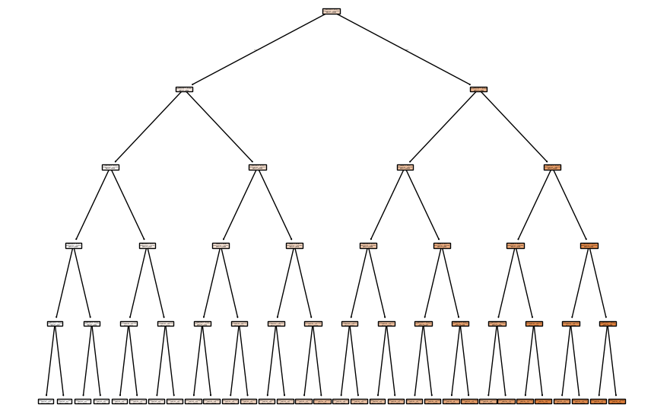
Decision Tree

Slide 28
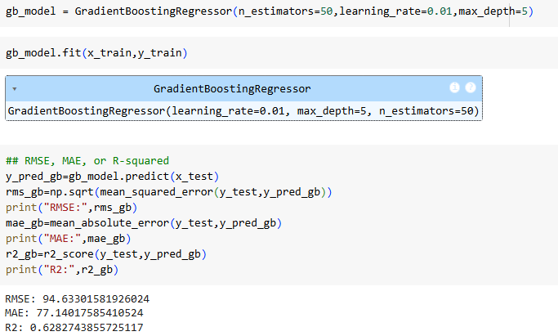
Gradient Boosting Regression

Slide 29
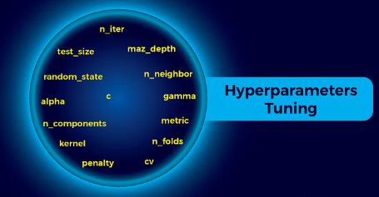
Hyperparameter tuning
Conducting hyperparameter tuning models
Evaluating model performance with different hyperparameter values using cross-validation techniques.
Balancing model complexity and performance to prevent overfitting or underfitting.

Slide 30
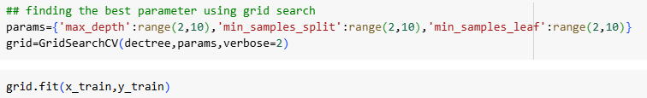
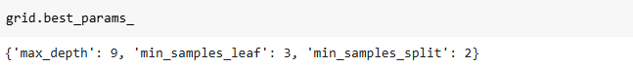
Conducting hyperparameter tuning for Decision Tree,Random Forest,and Gradient Boosting Regression using techniques like grid search or random search to find the best combination of model parameters.
Decision Tree : Conducting grid search technique to find best parameters
The best parameter is found is used to build new model using these new updated parameters

Slide 31
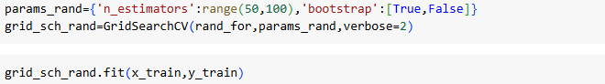
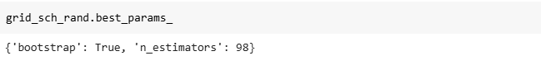
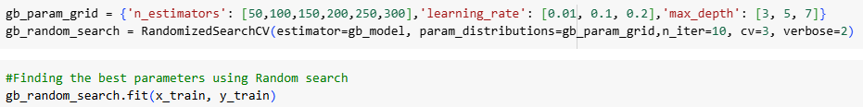
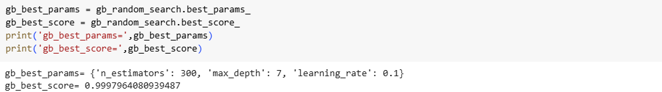
Random Forest : Conducting grid search technique to find best parameters
Gradient Boosting Regression: Conducting random search technique to find best parameters

Slide 32
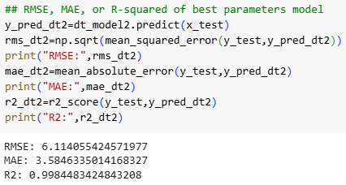
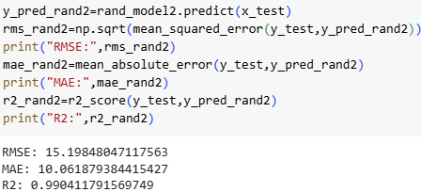
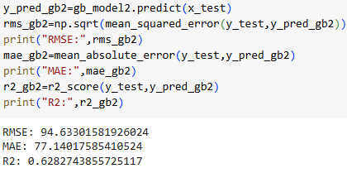
Comparison between three models after applying best parameters obtained using grid/random search method
Decision Tree | Random Forest | Gradient Boosting Regression

Slide 33
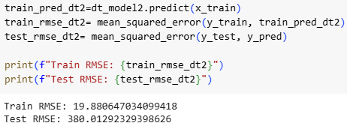
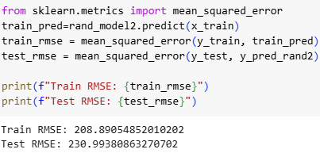
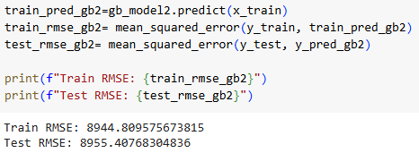
Balancing model complexity and performance to prevent overfitting or underfitting.
Overfitting Check: If the training RMSE is much smaller than the test RMSE, the model may be overfitting.
Decision Tree | Random Forest | Gradient Boosting Regression
The RMSE of training data is very less than testing data RMSE,so the model is overfitting | The RMSE of train and testing data is almost equal | The RMSE of train and testing data is almost equal

Slide 34
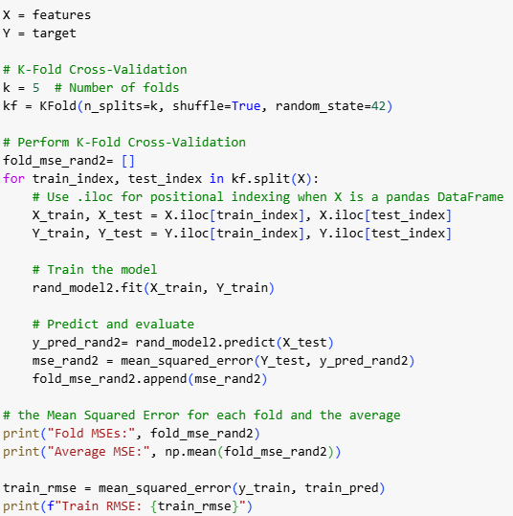
Evaluating model performance with different hyperparameter values using cross-validation techniques.
Considering various parameter using the random forest model for further analysis,therefore using cross-validation technique over it
Output:
Since the average mean squared error of training set and testing set are almost equal the model is not overfitting nor underfitting

Slide 35

Model Evaluation:
Based on the performance of models like Random forest Regressor , Decision Tree and Gradient Boosting Regressor:
Random Forest Model yields the best results ,99% of the variability in the target variable is explained by the model
The random forest model also doesnot overfit or underfit the data

Slide 36

Model Deployment
Deploy it in a production environment where it can be used to make predictions.

Slide 37
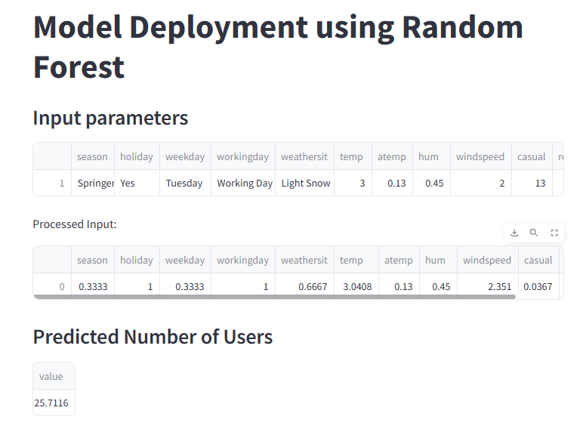
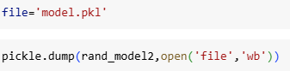
Saving the model in pickle file
Model deployment
Building a user-input environment using streamlit
Obtaining data from user
Preprocessing the data
Using the model in the pickle file to displaying the result to the user

Slide 38
Links
Local URL : http://localhost:8501
Network URL : http://192.168.179.130:8501
EDA and model building
Model deployment file:
Model deployment link:

Slide 39
Packages used in the project
Pandas : to load dataset
Numpy: to replace invalid records by nan
matplotlib.pyplot : visualisation
Seaborn: display heatmap
statsmodels.tsa.seasonal : time series decomposition plot
sklearn.preprocessing import LabelEncoder : for label encoding
sklearn.tree import DecisionTreeRegressor,plot_tree : Decision Tree model
sklearn.metrics import mean_squared_error, r2_score, mean_absolute_error : Perfomance metrics to analyze models
sklearn.model_selection import GridSearchCV: to find optimized values for hyper parameter
Pickle : Dumping and storing the model
Streamlit: model deployment

Slide 40
sklearn.ensemble import GradientBoostingRegressor : Gradient Boosting Regressor model
sklearn.model_selection import RandomizedSearchCV : Random Search to find best parameter
sklearn.ensemble import RandomForestRegressor :Random Forest Regressor model

Slide 41
Challenges faced
We faced issue during Model deployment part
We have scaled the target column too which yielded wrong result
To overcome that the features were again scaled after dropping the target column
During model deployment we also faced one more issue, the user input data has to be pre-processed before providing the data to the pre-built model for analysis
This caused us to get wrong results to which was again corrected by adding a separate defined function for pre-processing.
We remember that the streamlit is case-sensitive too as we have faced a lot of confusion in that part.

Slide 42

Thank you

